Slide 1
CREATING E-LEARNING MATERIAL
OF
“CREATING AN INCLUSIVE SCHOOL”
Presented By
KRISHNA COLLEGE OF EDUCATION
Meyyur village and post, Tiruvannamalai Taluk and District
Cell : 9790803995
Mrs. P.CHITRA
Research Scholar
Department of Pedagogical Science
TNTEU, Chennai – 600097

Slide 2


Slide 3
Abstract
To develop an understanding of the Concept of Disability.
To develop an understanding of the Concept of Learning Disabilities.
To critically evaluate the Models of Disability
Identify the need and importance of inclusive education.
To discuss the contributions of National and International Agencies to Inclusive Education.
To critically discuss the Global Policies and Programmed.
To know about the Barriers & overcoming Barriers in inclusive Education.
To discuss about the Education system Disability in India.
To develop an understanding of the concept of Initiatives for Expanding Inclusive School.
To discuss about ‘Education for All’ , ‘Integrated Education 'and ‘ Inclusive Education’.

Slide 4
INTRODUCTION
Education’ is one of the basic rights to the human beings. There is no doubts that an education alone gives personality development among the people. Children get discipline , Social attachments, intelligence skill, motivation through an education .In our country national education gives to normal children and special education gives to special children . the main objectives of special education is changing in behavior attitude among the students let us see about disabilities, type their identification , their education systems principles and acts.

Slide 5
Creating an Inclusive School
Understanding the disabilities
Understanding the learning-Disabilities
Models of disabilities
Barriers in providing inclusive education
Creating an inclusive school
Overcoming Barriers in inclusive Education
Mixed ability grouping and teaching
Global Policies and programmers of inclusive education
Inclusive education

Slide 6
Disability
In our India, They give special education to disabilities .Our country followed the system of education according to philosopher swami vivekananda’s philosophy is “ an Education goes to reach the disabilities.

Slide 7
Disability - Concept
There are many reasons to born disabilities in this word. Pre-natal causes ,Peri natal causes & Post natal causes are the major reasons for the disability. There are many types of disabilities are: like:- Dislexia,disgraphia,dyscalculia and dyspraxia etc.....

Slide 8
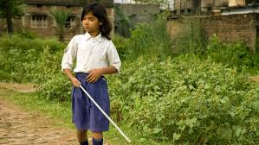
Visual Disability
Characteristics of disabilities:
Disabilities had such difficulties while comparing with normal children. They are backward in physically mentally.
Part of visual disability fully visual disabilities are called visual disability 5% visual disabilities are lived in India.

Slide 9
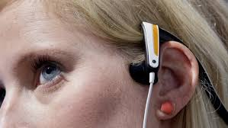
Hearing disability
Next to the hearing disability is visual disability. Sound is measured by decibel 50 decibel and more than 50 decibel having hearing capacity is called hearing disability.
Sl.No | Decibel Level | Types
1 | 0-25 | Normal Condition
2 | 26-40 | Medium Condition
3 | 41-70 | Middle Condition
4 | 71-90 | High Condition
5 | 91 | Complete disability Condition

Slide 10
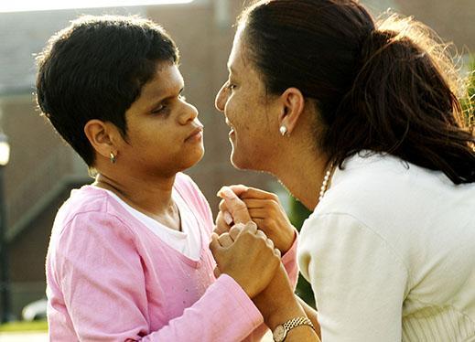
Speaking Disability
Speaking Disability:
Speech means ‘Usage of language with correct pronunciation ,pause, stress and voice modulation (High pitch, low pitch)
If we can’t use following things . We are known as speaking disabilities
Through lip reading , auditory training –Speech training can improve their hearing abilities

Slide 11
Mentally disabilities
Below 70% IQ having children are normally called as mentally disabilities . They are backward in knowledge development , Emotional development
They are 3 types.
Mentally disabilities
Morons
Imbeciles
Idiots
Imbeciles
Idiots

Slide 12
Learning Disabilities
Students are having various IQ level , Personality development, learning speed, because
they are from various family situation, economical background. They teacher should identify the learning
disabilities . He / She gives special training to them.
Reasons for Learning disabilities:
They are so many reasons for this learning disabilities. They are as
Pre-Natal causes
Peri-natal causes
Genetic factors
Post-natal causes

Slide 13
Types of learning disabilities
Dyslexia
Difficulty in spelling, phonological processing
Disgraphia
Difficulty in identity the letters
Dyscalculia
Difficulty in adding , Subtraction , multiple, Division
Dyspraxia
Difficulty in psychomotor

Slide 14
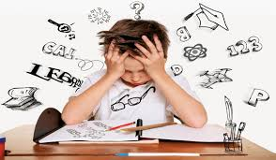
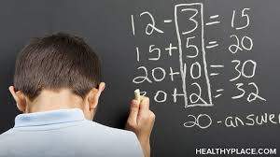
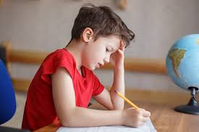
Learning Disabilities

Slide 15
IDENTIFYING CHILDREN WITH DISABILITIES
Knowledge based approach
Sensory based approach
Disability based approach
Social based approach

Slide 16
Education guidelines for disabilities
Mastery Model
Classroom adjustment
Classroom helpless
Special education
Special Equipment
Mastery Model

Slide 17

Models of Disabilities
Models help to knowing something to the audiences. This model are called are impairment or disability models. It has many merits and demerits.
It Creates such defaults in some experiments.
It can’t give proper solution in every situation.
It makes such negative thoughts among the disabilities.
It was ignored by such critics in somewhere places.

Slide 18

It helps to solve the difficulties of the disabilities.
It helps to implement among the disabilities.
It helps to identify their difficulties easily
It helps to explain about their problem and solutions

Slide 19
Types of models
Social model of disability
Medical model of disability
Nagi model of disability
Quebec disability production process model
Human rights model of disability
Professional model of Disability
Transactional model of disability
Charity model of disability
Functional or economic model of disability
Rehabilitation model

Slide 20

Explanation of Quebec Disability Model
Risk Factors
Personal factors
Structure of the body
Capabilities of the action
Environmental factors
Life habits
Positive Habits
Negative habits
Interaction

Slide 21
Inclusive Education:
Normal special children learn in same school and normal school teachers should
Learn from pre service-training , In service –Training and post service training to handle special children in normal school. It is called as inclusive education
Education for all:
It was started in 1950 under the Act of ‘45’ . Free and compulsory education must gives to ‘from 6 to 14 age ‘ children without any partialities is called as education for all

Slide 22
Barriers in proving inclusive Education
Negative Attitudes
Funding required
Easy accessibility
Curriculum
Language and communication
Co-operation
Government policies
Social-economic reasons

Slide 23
Overcoming the barriers in inclusive
education
Control negative attitudes
Creating highly learning situation
Curriculum and evaluate the students achievement
Increasing the family members involvement
Social participation
Special training given to the educators
Changes in government policies

Slide 24
Mixed ability grouping and teaching
Same methods of teaching , average learners centered teaching , teacher centered teaching are not possible to given “Education for all” in normal schools . So we have to followed mixed ability grouping and teaching method .Every students of this group must have 5 to 6 training skills. They are as :
Best learners
Average learners
Slow learners
Learners
Physically disabilities
Mixed disabilities

Slide 25
Teaching a multiple ability group
Interaction classroom
Co operative training
Collaborative training

Slide 26
Developing initiatives for expanding
Inclusive schooling
In India, teachers training for special education was given by regular classes, Distance Education . Teacher who were involved in the special education they have following trainings. They are as given below:
Pre-service training
In service training
Post service training

Slide 27
Global policies and programmes on inclusive education
There are many global policies and programmers on inclusive education. They are as:
Guidelines for action –Tallinn (1989)
Jometien conference (1990)
Dakar conference (2000)
Salamanca conference (1994)
U.N Convention on the rights of persons with disabilities(2006)

Slide 28
Changes from 1960 to 1994
Inclusive Education of the Disabled at the Secondary Stage (IEDSS)
The Right to Education act-2009
People with Disabilities act-1995
National policy for people with disabilities
Sarva Siksha Abhiyan(SSA)-1997-2002
Kothari commission (1966)
Programmed of Action on NAP -1992
The Integrated Education of Disabled Children (IEDC)-1974
The Integrated Child Development Scheme (ICDS-1974)

Slide 29
Conclusion
In India most of the policies and programmers were started the basis of ‘ Education for All’. With the help of such Welfare Committees, special children can got Education in normal schools. This is golden changes of of that era. So they can easily succeeds in everything by this type of Inclusive Education system

Slide 30
